Slide 1

Spatial Analysis of Crash Data Statistics
-Sujith Roy S

Slide 2
Overview
Open Data Crash Statistics:
Waka Kotahi Open Data
Spatial Insights:
Wellington Region (2018-2020)
Tools:
R/ Rest API Calls/ Leaflet Mapping

Slide 3
Higher level Statistics

Slide 4
Higher level Statistics

Slide 5
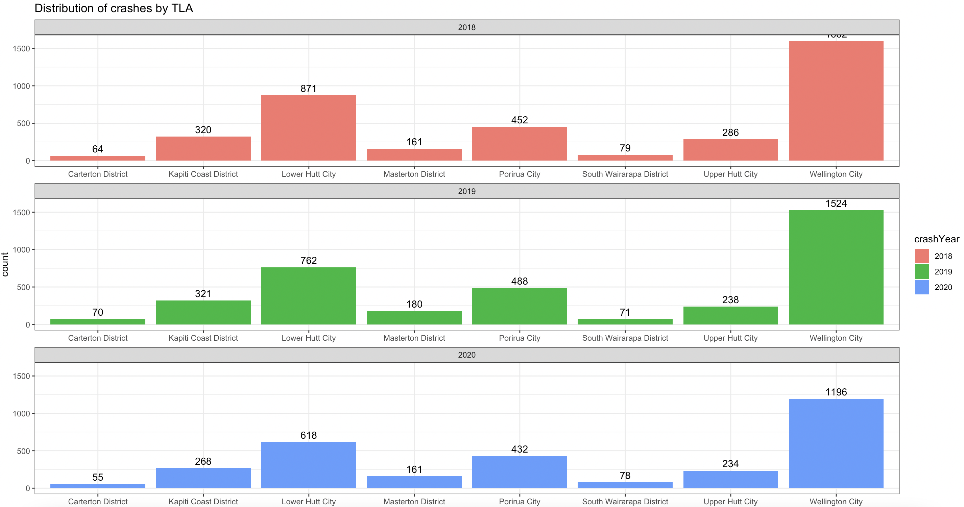
Statistics – Breakdown by Territorial Name

Slide 6
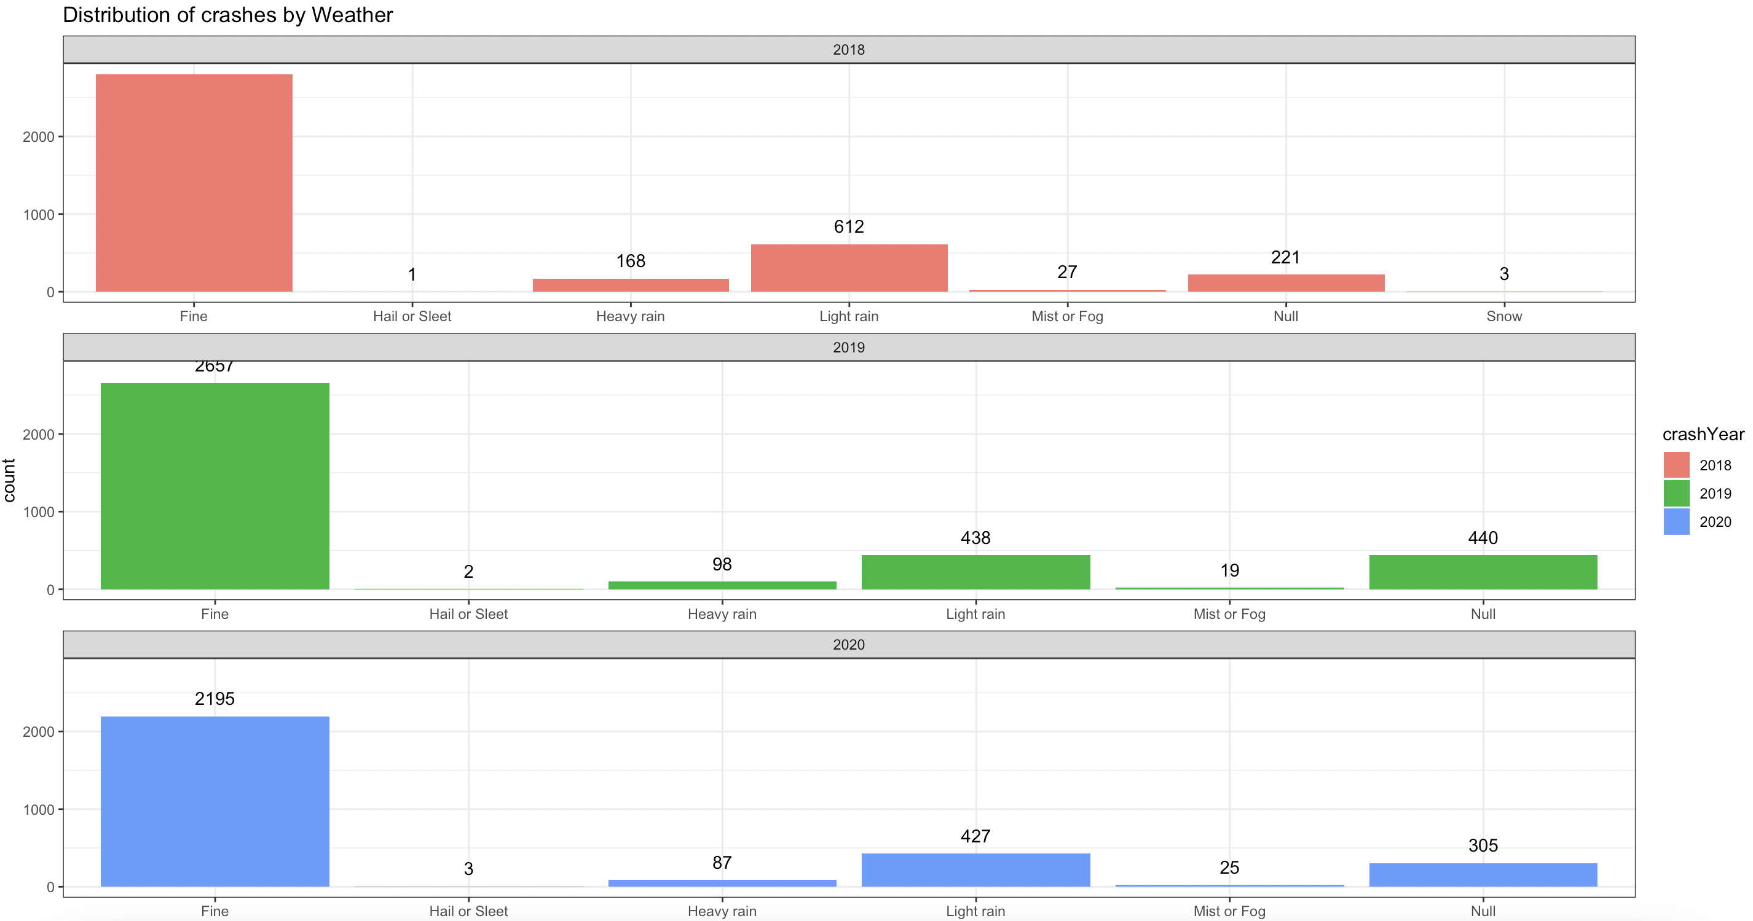
Statistics – Breakdown by Weather

Slide 7
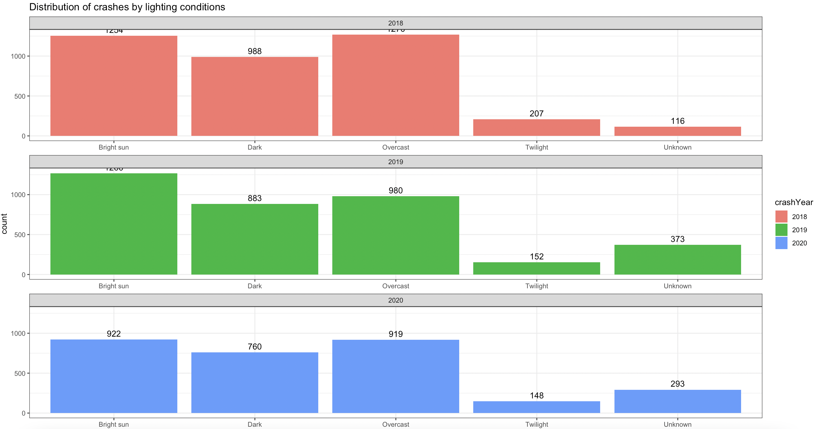
Statistics – Breakdown by Lighting Conditions

Slide 8
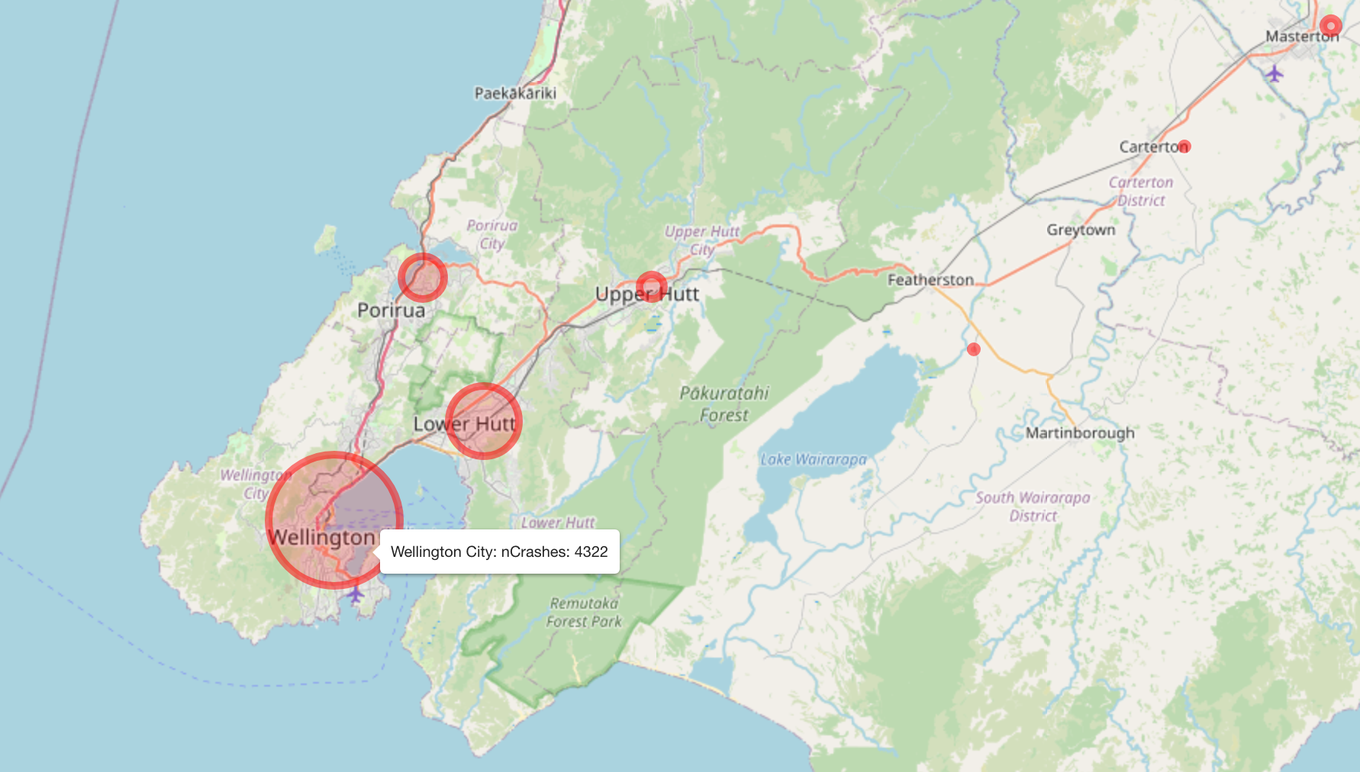
Crashes by Region

Slide 9
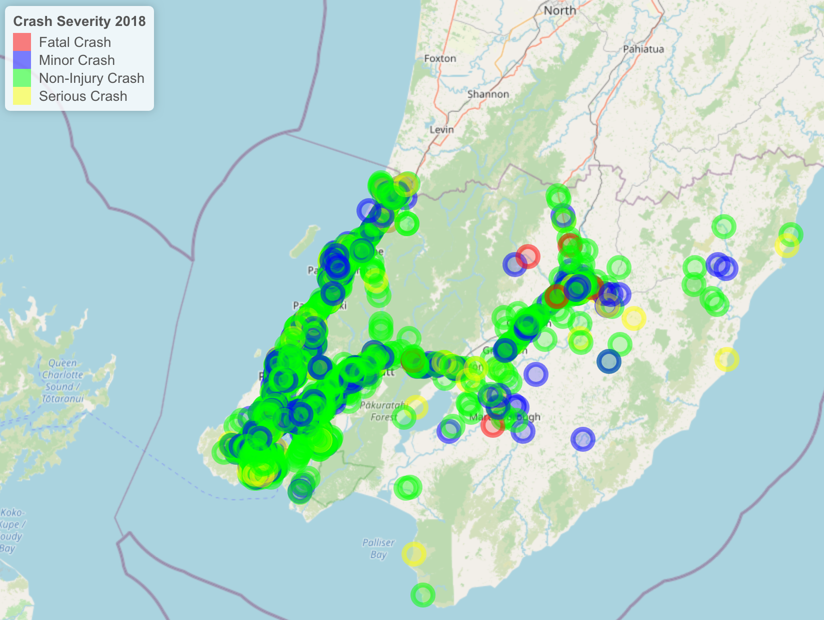
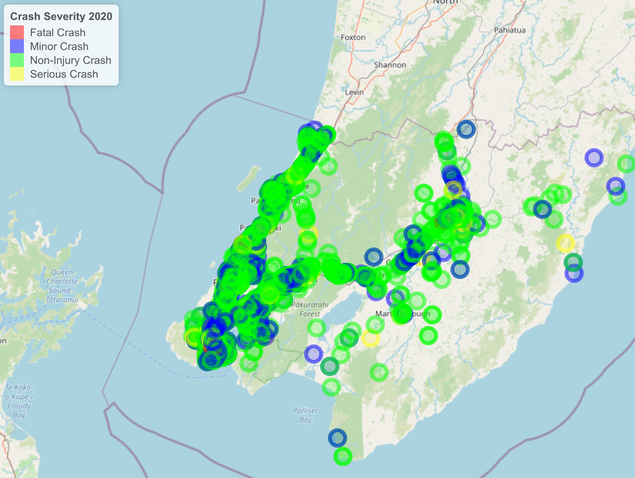
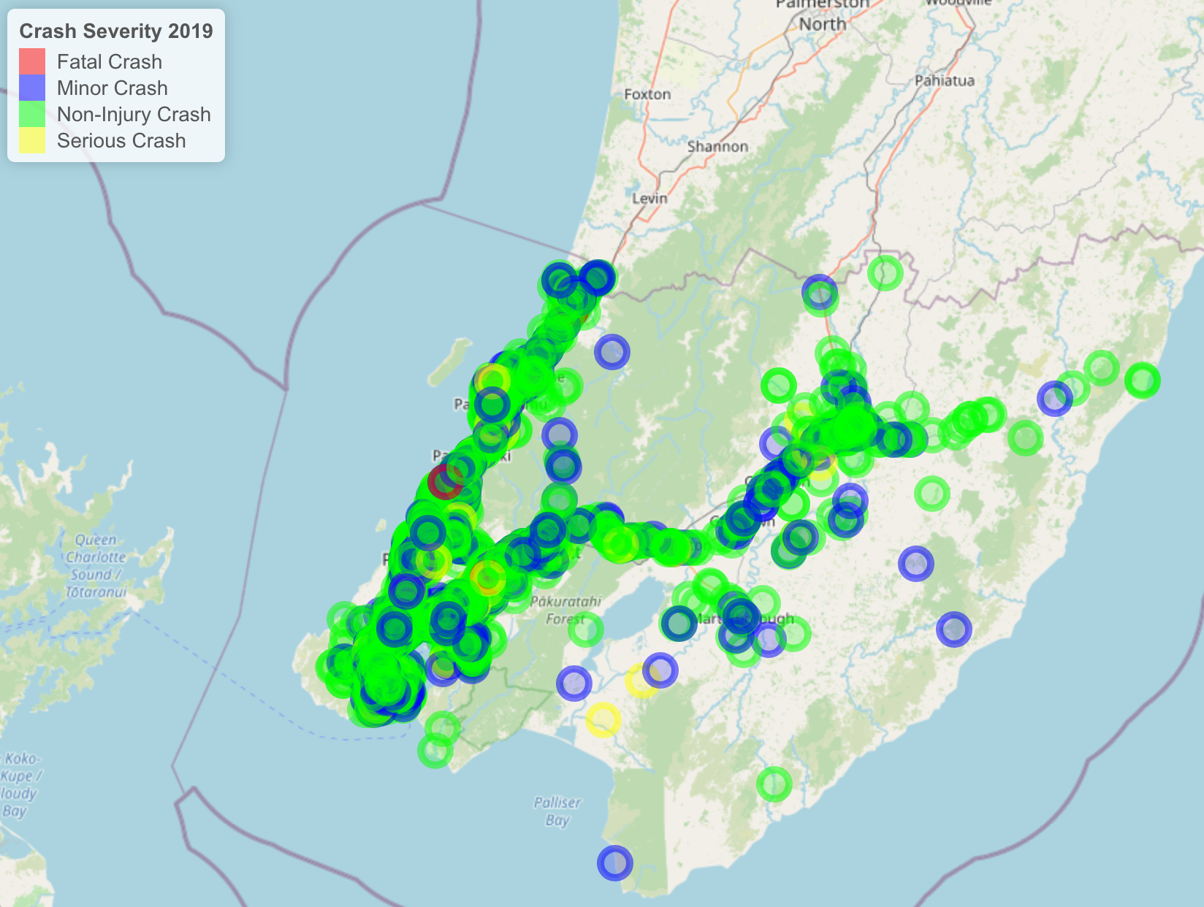
Distribution of Crashes across 3 years
Distribution of Crashes - 2018:2020

Slide 10
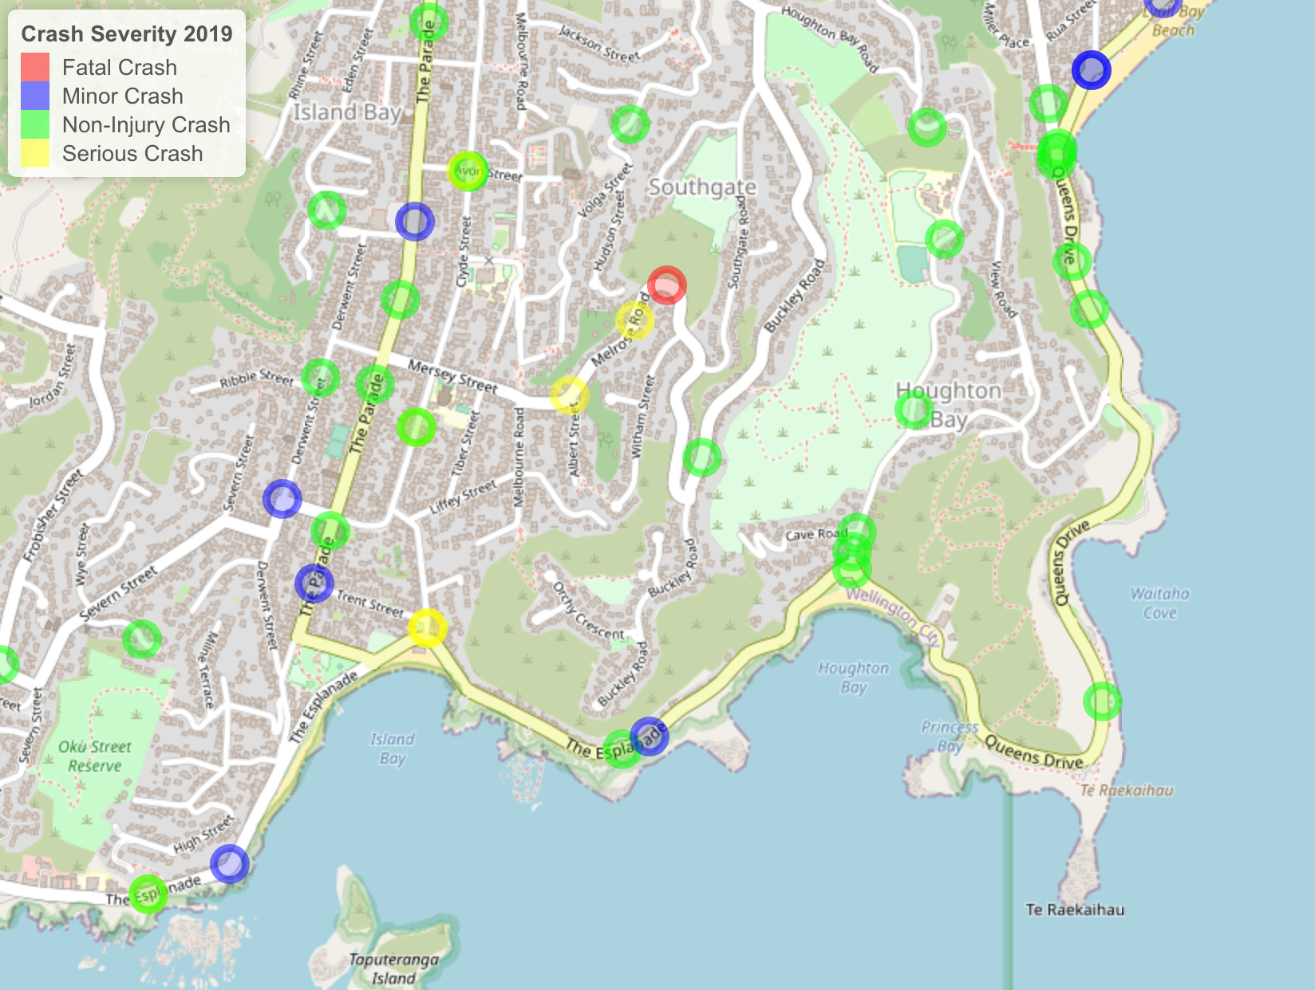
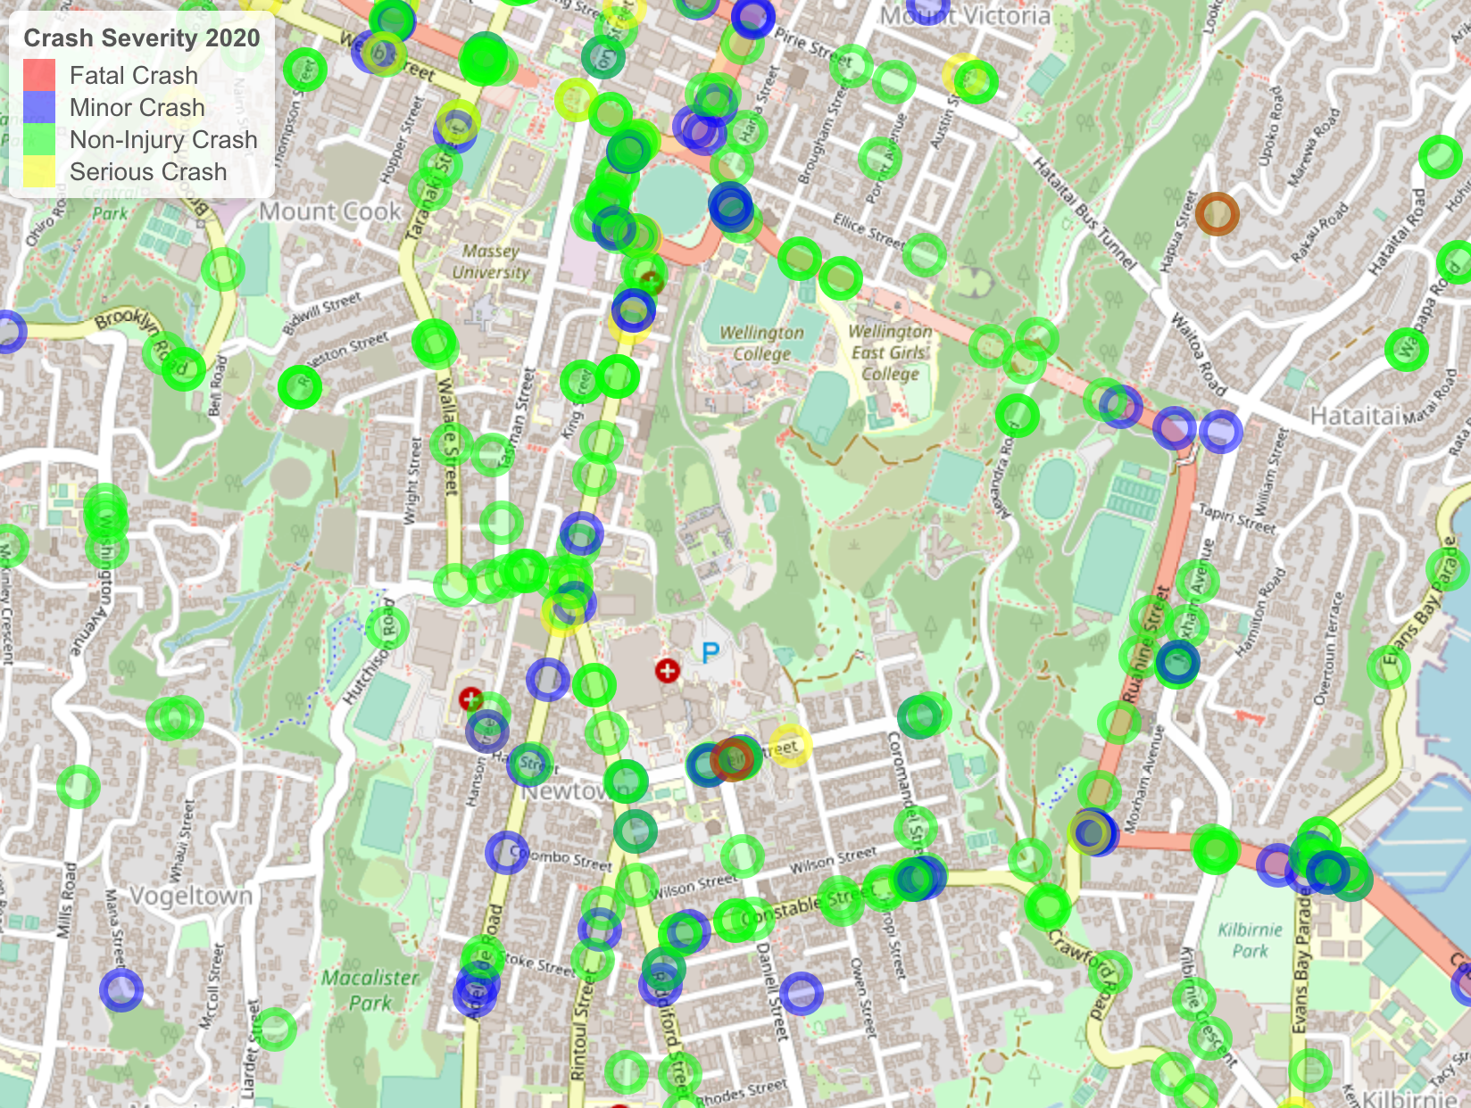
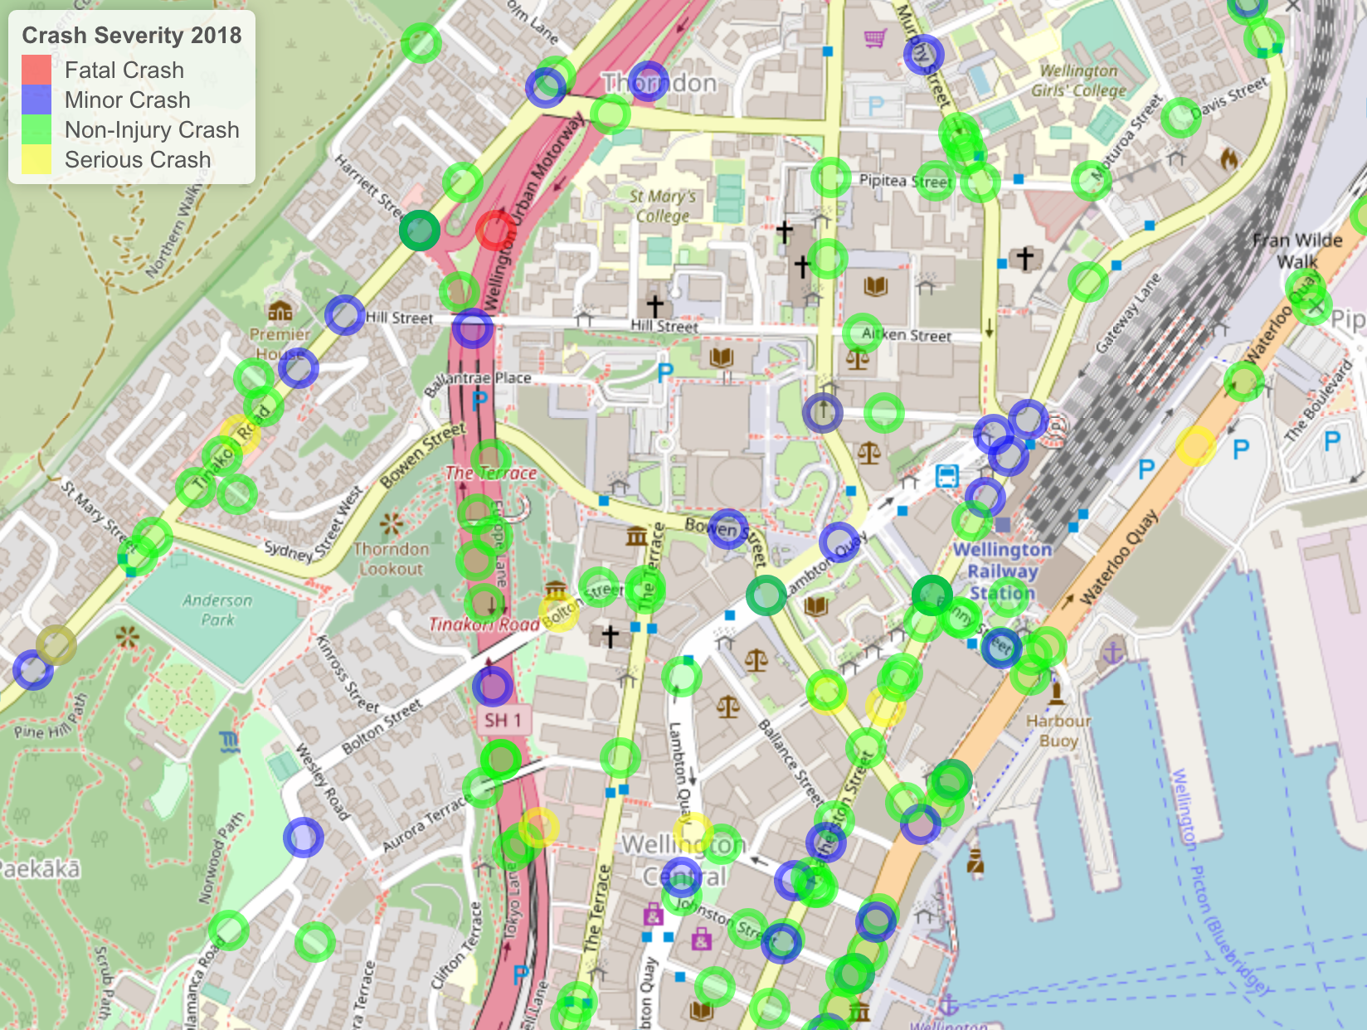
Distribution of Crashes - 2018:2020
Street Level View

Slide 11
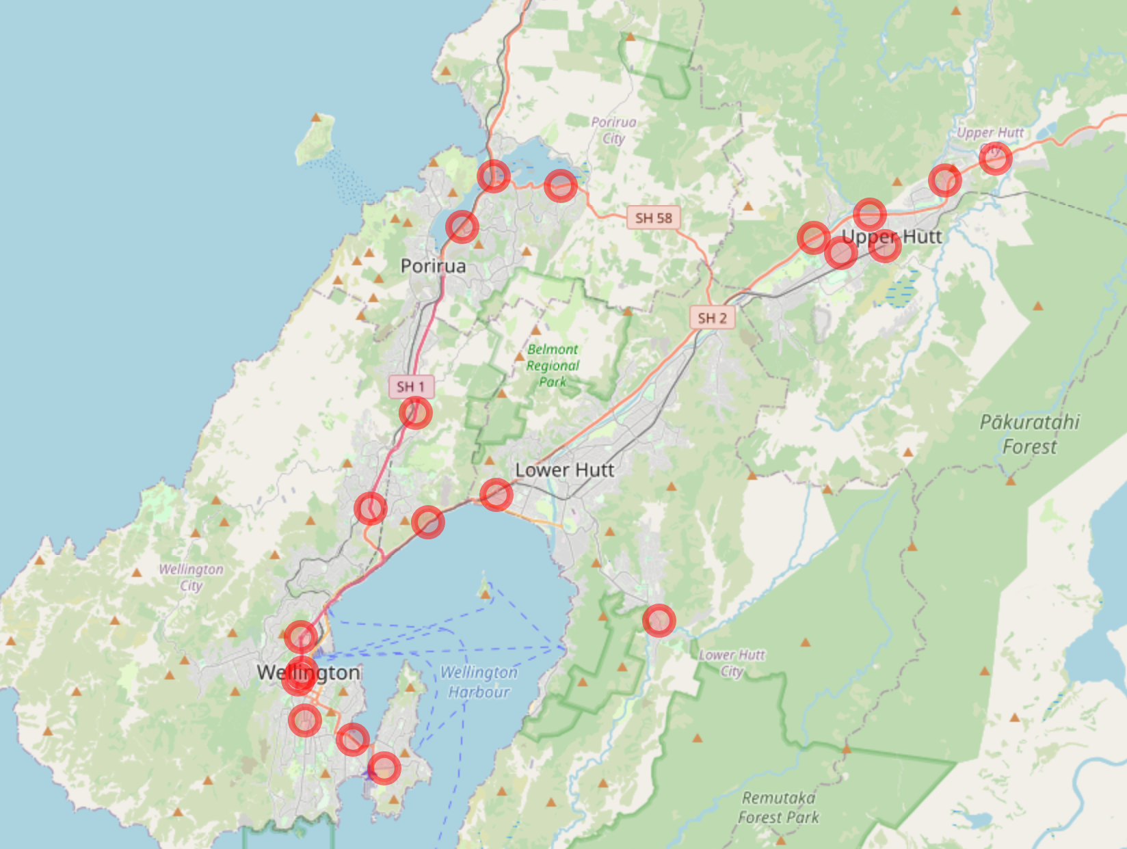
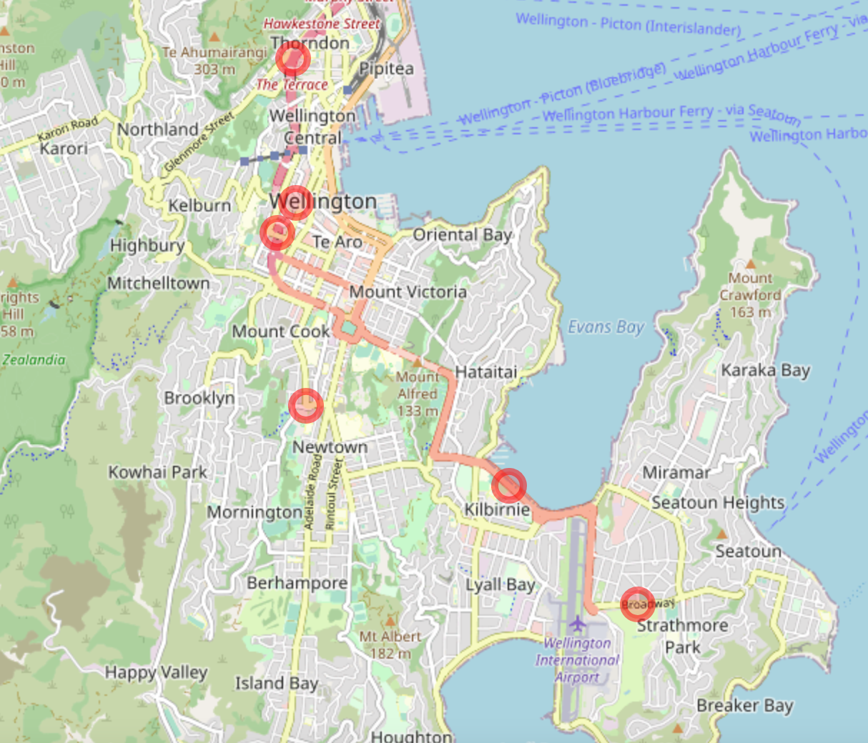
Fatal Crashes – 2018:2020

Slide 12

Modelling
Unsupervised statistical modelling
Hypothesis: Are these crashes randomly distributed or is there a specific pattern?
Clustering algorithm: Hierarchical clustering – Grouping based on similarity

Slide 13
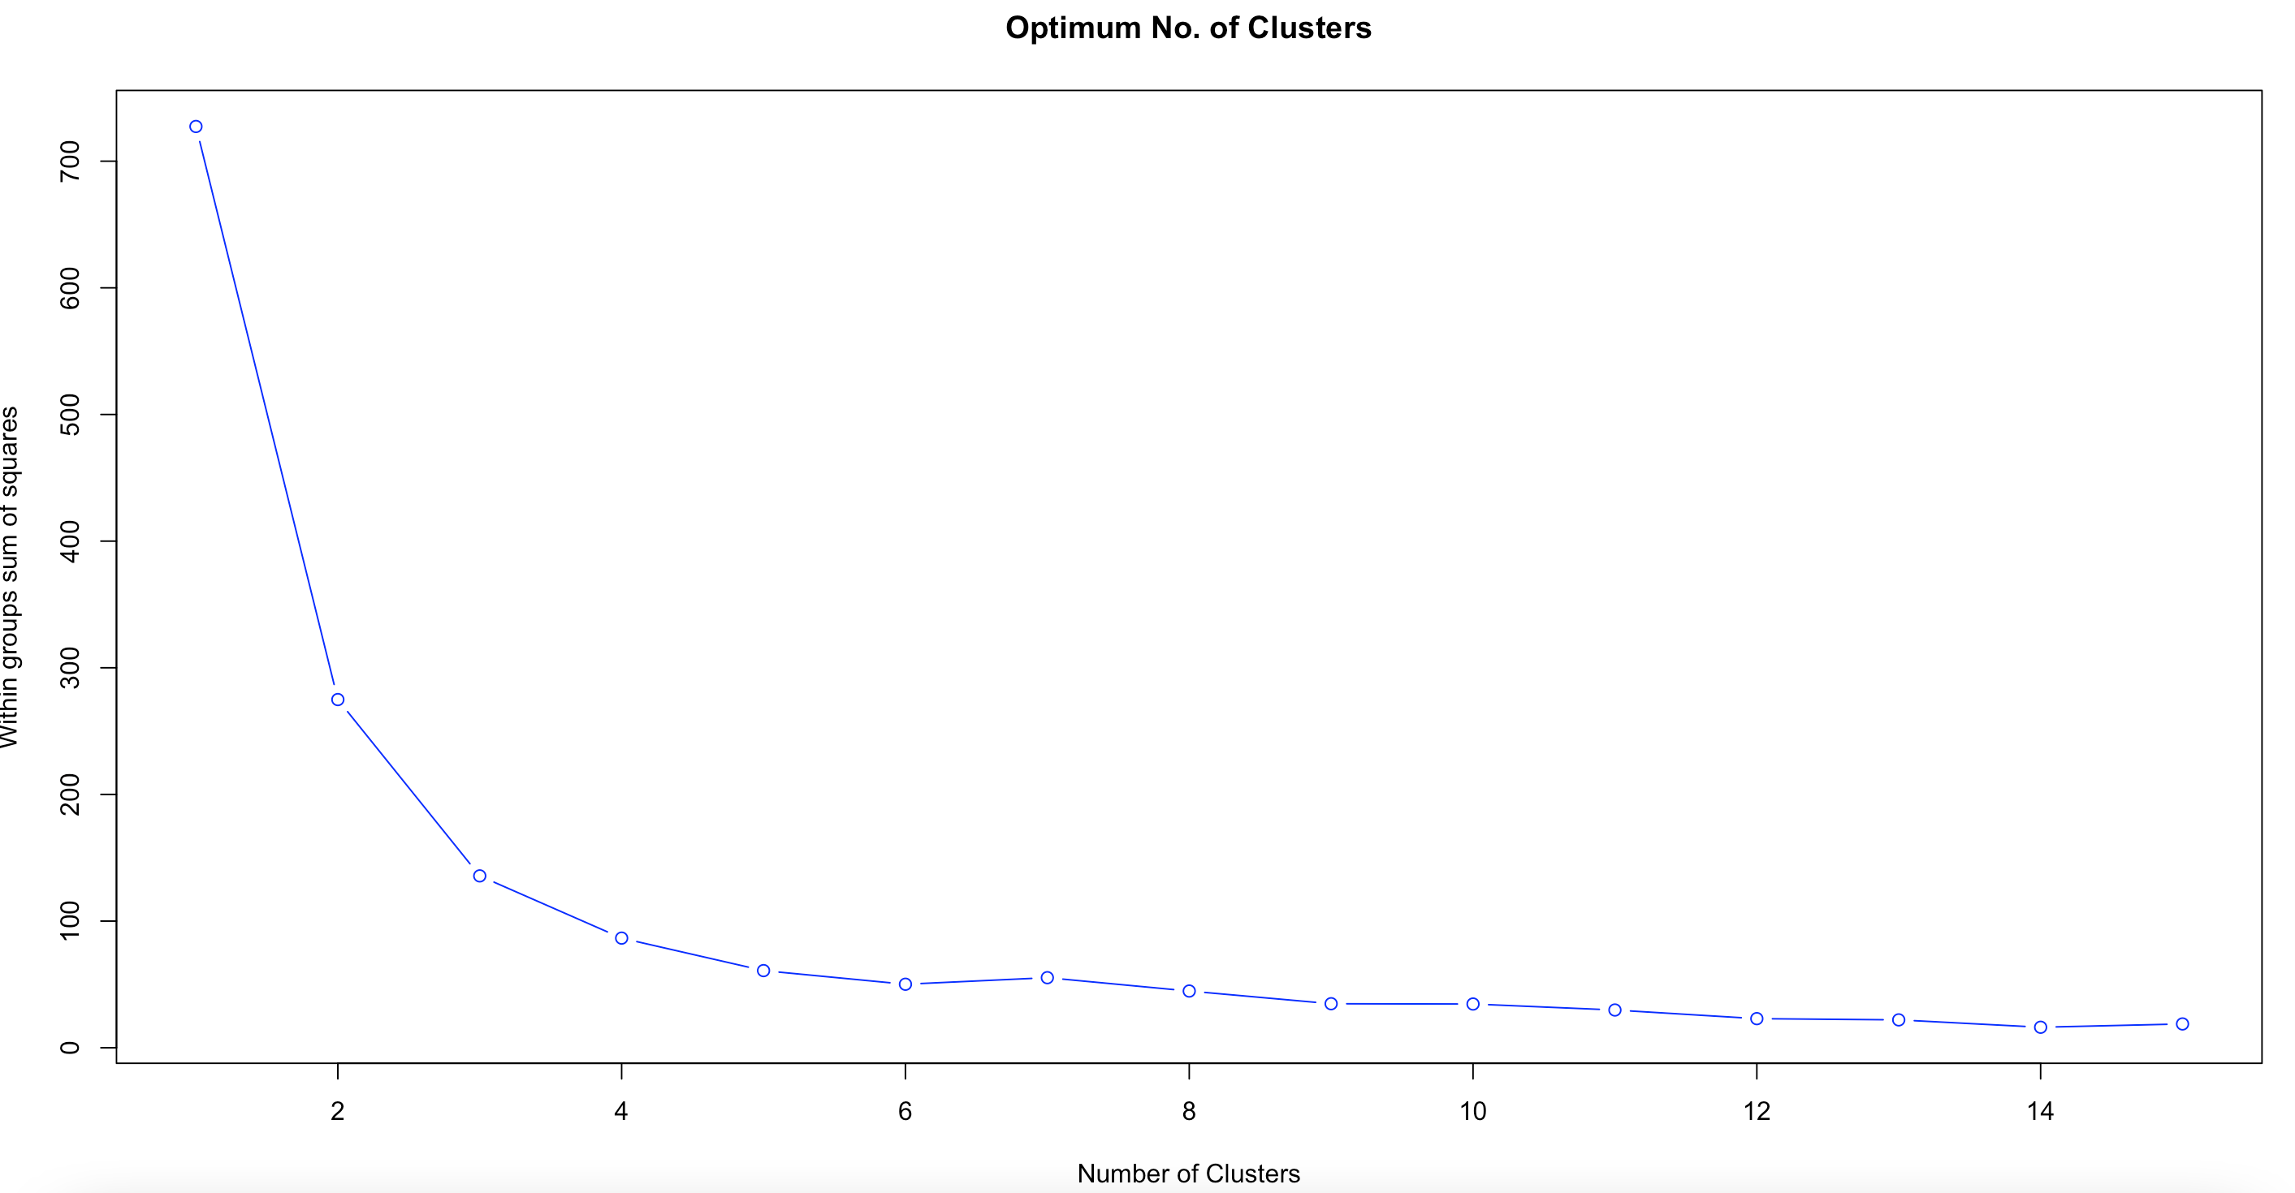
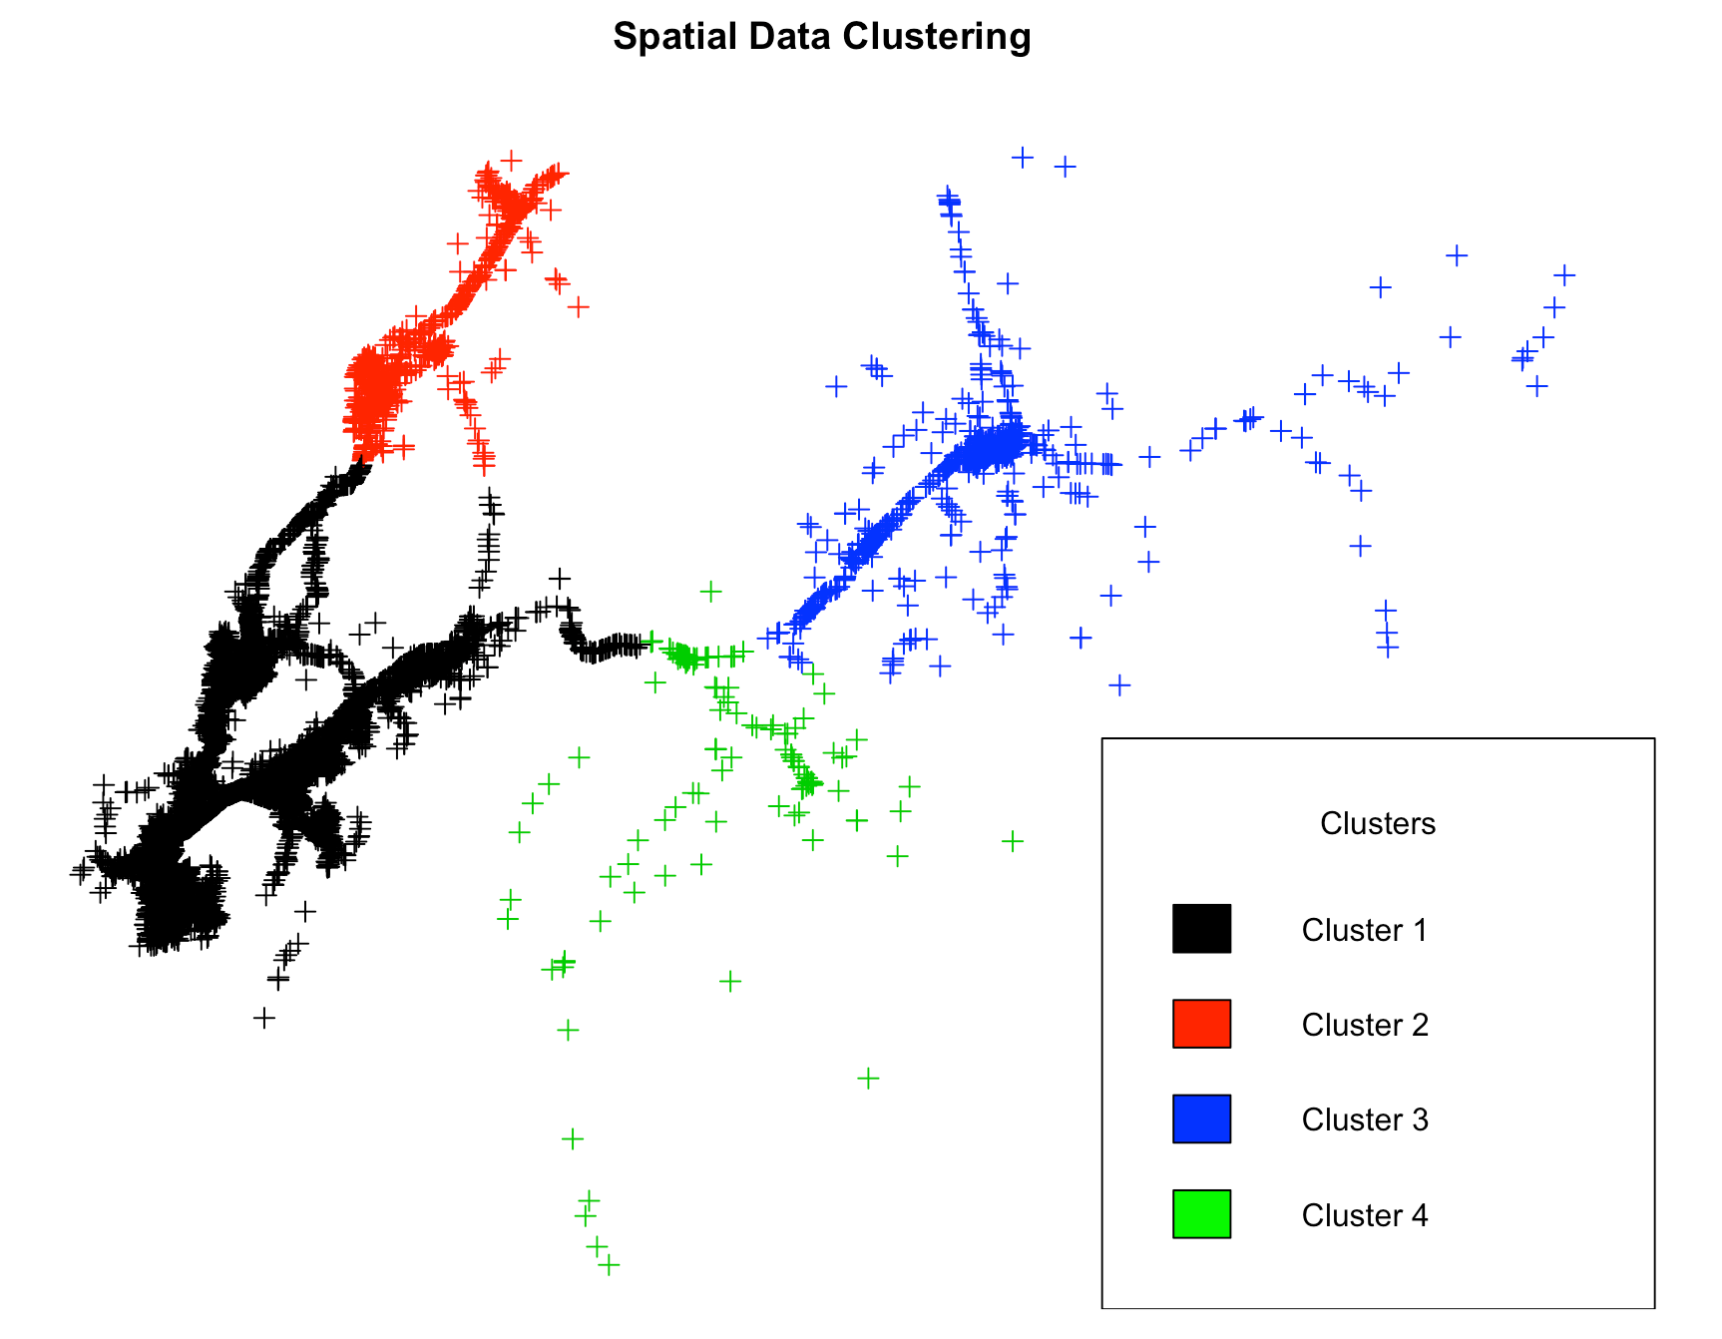
Hierarchical Clustering

Slide 14
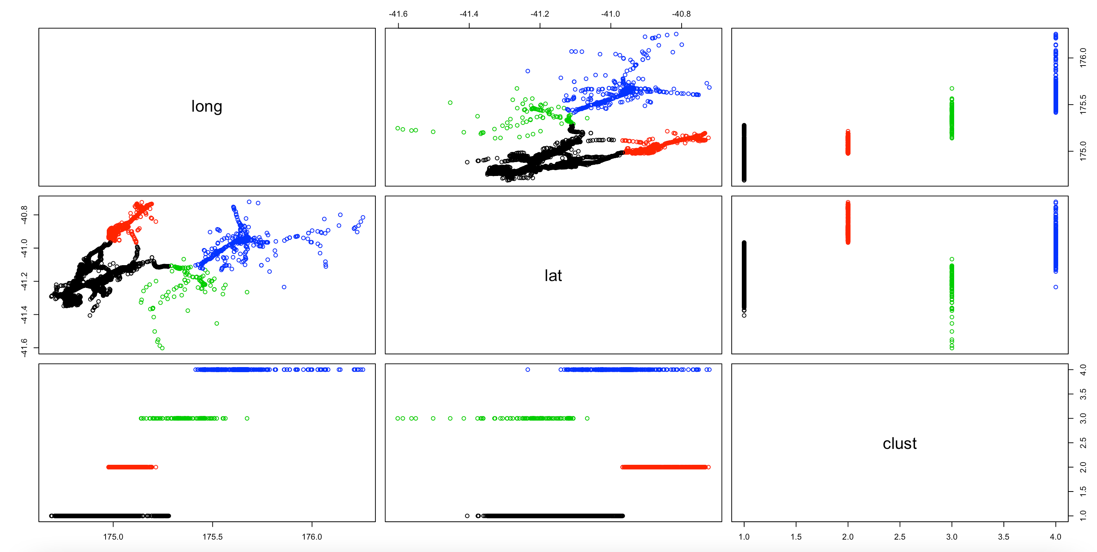
Hierarchical Clustering - Results

Slide 15

Conclusion & Future Work
The crashes are clearly randomly distributed
Analysis with more features and at a Meshblock level may reveal some hidden pattern
Access to traffic flow data will help us produce more significant results
Availability of time-based elements like day/date/time can be significant features for modelling crash statistics
Neural based networks are the future for crash statistics modelling

Slide 16
Challenges/ Moving to Production
Open Data API for data fetch
Simple reproducible modularized code base
Minor changes to scale the model to other NZ regions
Low computational resources – can work on standalone systems
Interactive graphs can be easily ported to a Markdown file or dashboard

Slide 17

Thank You

